Slide 1
Comparative Advantage and Digital Trade
Alan V. Deardorff
University of Michigan
For presentation at
International Trade, New Technologies and International Organization of Production
ITSG – Italian Trade Study Group, Politecnico di Milano
May 17, 2019

Slide 2
The Law of Comparative Advantage
Ricardo’s Law of Comparative Advantage
Formulated for a world where all trade was in goods, produced within countries, then transported between countries
Two purposes
To explain the pattern of trade
To illuminate the gains from trade

Slide 3
The Law of Comparative Advantage
Statement of the first purpose, to explain trade:
Trade if not distorted is based on countries’ relative costs of production
Since costs may change with trade, best understood with autarky costs (and autarky prices)

Slide 4
The Law of Comparative Advantage
Theoretical developments
First explained with just two goods, two countries, and only one factor, labor
Extended to more of each, though with limitations
Chain of comparative advantage
Heckscher-Ohlin model

Slide 5
The Law of Comparative Advantage
Theoretical developments
Generality of C-A
In general predictions for every pair of goods/countries not possible
But C-A does hold on average across goods and countries, as correlation
By Dixit and Norman (1980)
By Deardorff (1980)
This was shown to hold for
Arbitrary numbers of goods, factors, and countries
Intermediate inputs
Trade costs

Slide 6
Services
Services
Not initially regarded as trade
Changed by Harry Freeman
Deardorff (1985)
Prompted by my mentor and co-author Bob Stern
Asked whether C-A applies to services trade

Slide 7
Services
Services
Modes
Cross-border supply
Consumer movement
Producer presence
Movement of natural persons
I also considered “trade services”
Services such as transport that are complementary to trade
Their providers do follow C-A

Slide 8
Services
Cross-border supply of services
This poses a problem for C-A
Uses factors from both countries
Autarky prices may show high costs in both, but low when combined
So autarky prices mislead for trade

Slide 9
Digital Trade
This brings me to the question of the latest form of trade: Digital Trade
I was asked by Simon Evenett to address this as I had for services: Does the Law of Comparative Advantage hold for digital trade?
Here (and in Deardorff (2017)) I talk through this question for five forms of digital trade that I’ve been able to think of.
“Comparative Advantage in Digital Trade,” in Simon Evenett, ed., Cloth for Wine? The Relevance of Ricardo’s Comparative Advantage in the 21st Century CEPR Press, Center for Economic Policy Research, 2017, pp. 35-44.

Slide 10
Outline
Five kinds of digital trade
Physical products
Digital product transmitted digitally
Services provided by digital means
Storage and applications on The Cloud
Online platforms supported by advertising
Conclusion

Slide 11
Digital Trade
Definition
USITC (2013)
“There is no standard or generally accepted definition for ‘digital trade.’ “
“the delivery of products and services over either fixed-line or wireless digital networks”
USITC (2014)
“defines digital trade as U.S. domestic commerce and international trade in which the Internet and Internet-based technologies play a particularly significant role in ordering, producing, or delivering products and services”

Slide 12
Digital Trade
My Definition
International commerce for which
the product itself is digital
and/or any of the following are done via the internet or a other digital technology:
advertising
ordering
delivering
payment
servicing

Slide 13
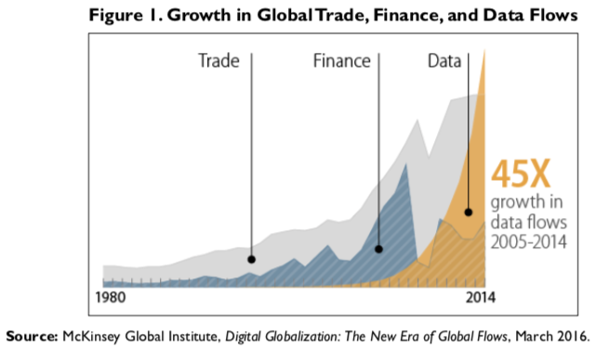
Source: Fefer et al. (2018)
Notes:
Fefer, Rachel F., Shayerah Ilias Akhtar, and Wayne M. Morrison, “Digital Trade and U.S. Trade Policy,” Congressional Research Service, May 11, 2018
https://fas.org/sgp/crs/misc/R44565.pdf

Slide 14
Digital Trade
I’ll look at five kinds of trade:
Physical products advertised, ordered, and/or paid for digitally, but transported by normal trade means
Digital products (music, movies, books, software) that are transmitted to purchasers via the internet
Services that are provided remotely by digital means
Data storage and computer applications accessible in “the cloud”
Web platforms that serve an international audience and are supported by advertising

Slide 15
Digital Trade
I’ll not look at
The “dark web,” which apparently may do much of the above, but invisibly and illegally.
Cryptocurrencies, such as bitcoin.
The physical infrastructure of the internet, such as the trans-oceanic fiber-optic cables that transmit the signals and are owned by companies that charge internet service providers for their use.
Other?

Slide 16
1. Physical Products
Become part of digital trade when advertised, ordered, and/or paid for digitally
Example: Amazon, in US takes order from Canada for a good produced in China
C-A?
Production still reflects C-A of China
Amazon is providing a “trade service” based on US C-A

Slide 17
2. Digital products transmitted digitally
Examples
Music
Text (books, etc.)
Video (movies, TV programs)
Computer programs

Slide 18
2. Digital products transmitted digitally
Distinctive feature
Zero marginal cost
Of both production and transmission
Positive fixed cost

Slide 19
2. Digital products transmitted digitally
C-A?
Doesn’t fit Ricardian Model
Model’s without perfect competition can still conform to C-A
Krugman (1981) (though he didn’t mention this)
I don’t know how general this may be

Slide 20
3. Services provided by digital means
Examples
Programmers taking assignments and delivering results over internet
Computer service provided with remote control of a computer
X-Rays read remotely
Manufacturer that builds in facility for remote monitoring and control

Slide 21
3. Services provided by digital means
C-A?
Cost of service depends on wages and other factor prices where service originates.
Thus does reflect C-A.

Slide 22
4. Storage and applications on the cloud
Remote computing is not new
Bob Stern and I used a mainframe computer that we never saw
But now clusters of servers hold
Data that can be processed remotely
Programs that can be run remotely
Called “the cloud”

Slide 23
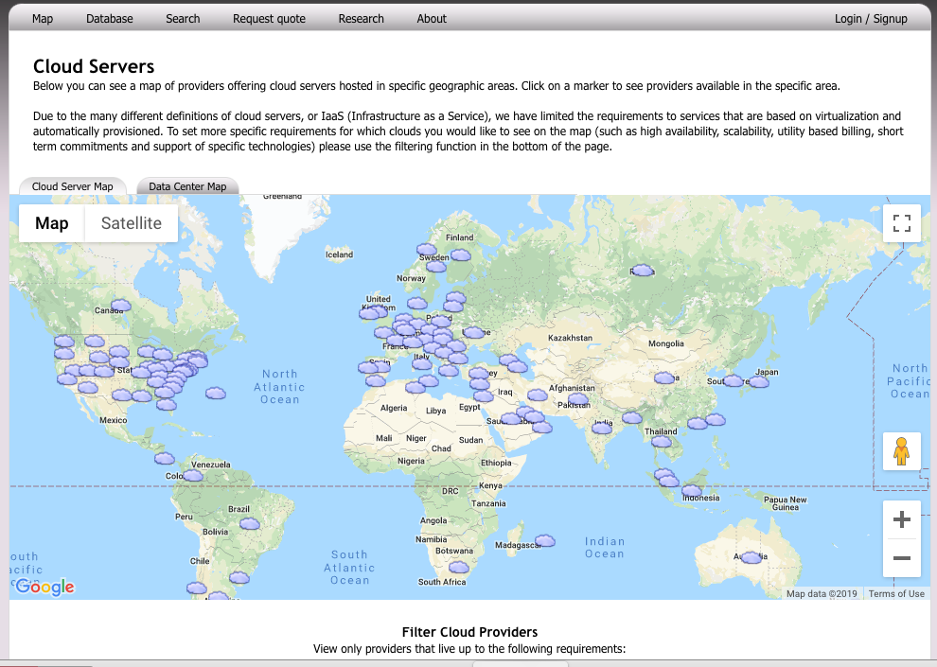
Notes:
https://www.datacentermap.com/cloud.html

Slide 24
4. Storage and applications on the cloud
Top Cloud Companies 2019:
Alibaba.
Amazon Web Services.
Google Cloud Platform.
IBM Cloud.
Microsoft Azure.
Oracle Cloud.
Source: Datamation
Notes:
https://www.datamation.com/cloud-computing/cloud-computing-companies.html

Slide 25
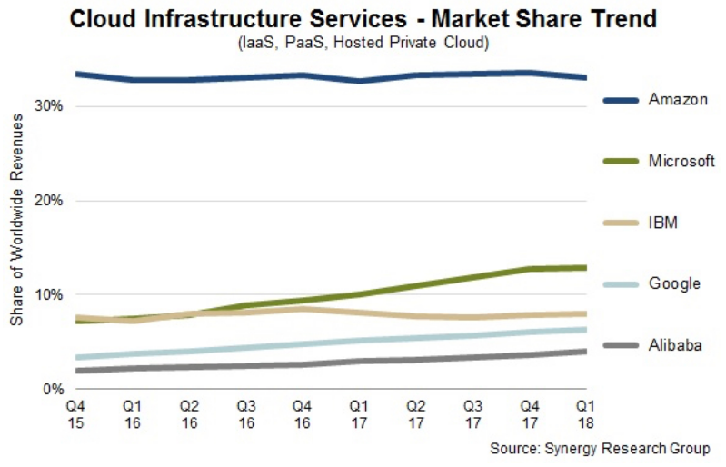
Source: Datamation
Notes:
https://www.datamation.com/cloud-computing/cloud-computing-companies.html

Slide 26
4. Storage and applications on the cloud
C-A
Servers require
Human and physical capital
Energy for processing and cooling
Each can be in a different place, based on costs

Slide 27
4. Storage and applications on the cloud
C-A
Like my case above of “cross-border services, none these places may have relatively low cost, and thus C-A, by itself
Indeed, it is ambiguous and thus arbitrary which location is said to be “exporting” the cloud service.

Slide 28
4. Storage and applications on the cloud
C-A
Costs are crucial, but C-A is not helpful for explaining this form of digital trade

Slide 29
5. Online platforms supported by advertising
Examples
Facebook
Instagram
WhatsApp
Google
YouTube
Twitter
Examples
WeChat
(WeChat)
(WeChat)
Baidu
Toudou Youku
Sina Weibo
Source: Dragon Social
Notes:
https://www.dragonsocial.net/blog/social-media-in-china/

Slide 30
5. Online platforms supported by advertising
What they provide
Platform for entertainment and communication
What they produce
Their users’ attention
What they sell
Advertising

Slide 31
5. Online platforms supported by advertising
Is this trade?
Yes, if provider and advertiser are in different countries
C-A?
Costs of providers are conventional: human and physical capital
But also networks

Slide 32
5. Online platforms supported by advertising
C-A?
Success depends also on “network effects”
A successful provider may have higher costs than others, if their history captured the network first
Network success may depend on market size
Hence advantages for US and China
Not S Korea, Finland

Slide 33
5. Online platforms supported by advertising
C-A?
Given the network, profit might be increased by move to where costs are lower
But this need not be in one place
Same problem as for the cloud

Slide 34
Conclusion
Is comparative advantage useful for explaining digital trade?
Yes for some, but not for others
Cloud services may harness costs from more than one country, in each of which autarky costs might be high
Platforms depend on network effects that depend more on country size than costs

Slide 35
Thank you. Questions?
Notes:
https://www.datacentermap.com/cloud.html

